Slide 1
Stigmergy for Multi-Robot Coverage: Demonstration Presentation
Michael Chadwick

Slide 2
Project Aims
Code a program to demonstrate the effectiveness of the Dark Room
Target System: e-Puck platform
Develop the ‘StiCo’ algorithm for the platform
Should interact with the glowing floor in some manner
Construct a Dark Room
Small enough to fit on a table approximately one meter in diameter
Quick to set up; Quick to dismantle
Uses glow in the dark foil as flooring

Slide 3
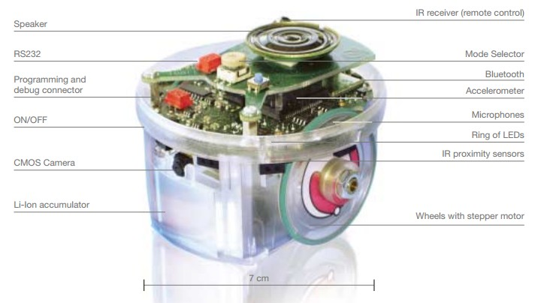
Platform: E-Puck
An open hardware platform
Designed mainly for educational purposes
Multiple sensors
IR for kinetic, Camera for visual
LEDs allow visual representation of information
Project focuses use of:
Camera to detect light trail on the floor
LEDs to generate the light trail

Slide 4
Algorithm: StiCo
StiCo is designed to aid patrolling robots
Localised messages for indirect communication
Light trail suggests a recently visited area
Circular movement pattern
When light is detected, swap direction

Slide 5
Arena
Boundaries are flexible to the user
Restricted only to the size of the table in use
Rope is tied between sturdy sections to provide arena limits
Arena edges can secure flooring underneath them
Glow in the dark foil for this project

Slide 6
Code Outline
Configure Camera
Infinite Loop:
Start Camera
Turn on ‘South’ LEDs
Find lightest point in the current image
Move away from the light source

Slide 7
Test Cases
Can the arena hold the robot?
Is the flooring secure enough?
Can the camera pick up the trails?
Robot-based tests:
Single robot interacting with activated flooring
Multiple robots interacting with each other’s trails

Slide 8
Human Data / Participants
No Human data has been used within this project currently
No Human data will be used for the remainder of the project

Slide 9
Thank you for your time
Any Questions?

